Slide 1
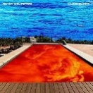
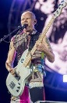
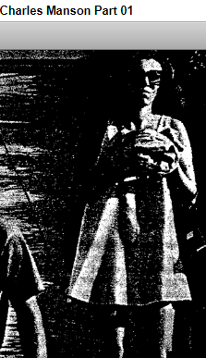
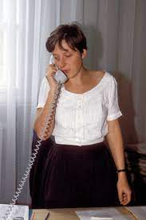
FBI
partner
development
IPX.INT
2005
HOMCID:GHOST.
ken.chlilpeter party (flea)
arron.chillypeter
VIRINGA 1996/7
G.VIRGINA roth.ibm.damiler.apple.greenstampe.touch
J5
(flea)
(flea).Angela
I saw flea
Rupuer
St. Martin.Angela
St. Franceceso.Angela
HOMICIDE:IS-A-BELL
EVIDENCE
HOMCE:LUX:ANGLEA
§Adultry
HOMICIDE:LUX
41.v2:FBI:KIDNAPPING
Has name Charles Mason in Mother FBI REPORT
!PAUL
§VIRGINIA
Democracy Germany
Sap(lindner)
HOMCEP:LUX(waldorf/sap
CONSITTION GERMANY
CONSOTN RUSSA
Fall of German and Russia
Coutner
SINGED JNM
IPX HOMC:MAYOR(boden/ariena)
ATOMBUNDKER(VIRGINA)
ATOMBOMB
Angela/St.Francisc(8thFloor).Angela/st. Martin.Angela/(flea) HAHN

Slide 2
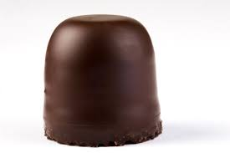
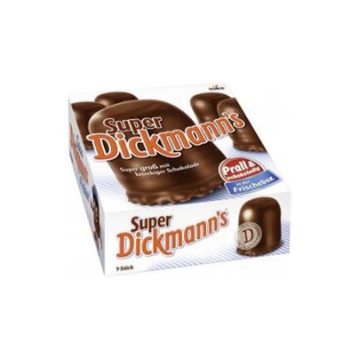
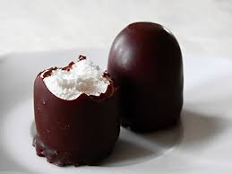

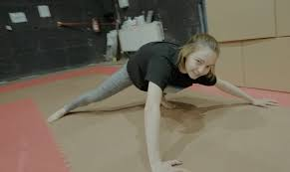
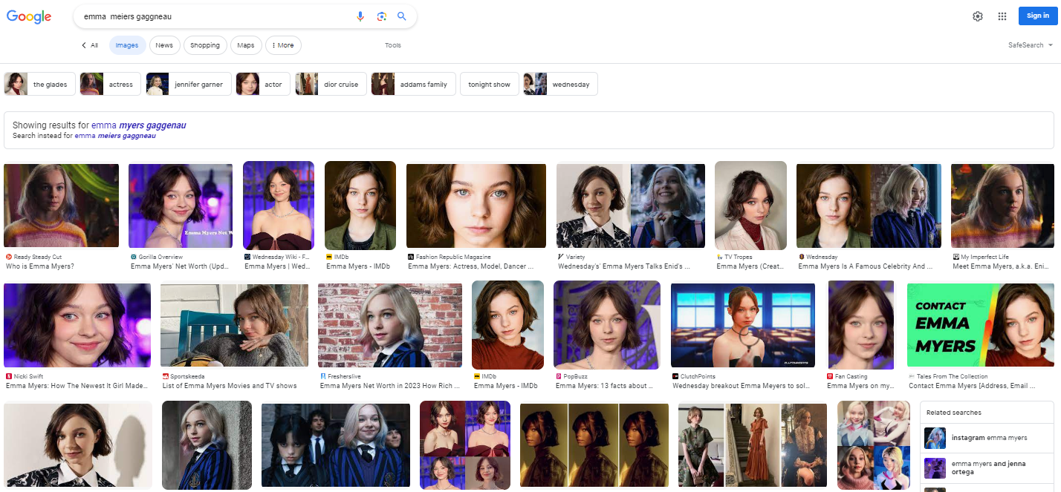
FBI
partner
development
1991
nonPoliceLani.lint(morenkopf)
2017
INTERUPT St. Rita (billboard stanford)
v2.FBI:KIDNAPPING St Rita INTERUPTS
2023
CVPA Search: Emma Helen Meiers, Emma Meiers
Gymnstics, Emma Meiers Gaggenau
HOMCE:LUX:ANGLEA

Slide 3
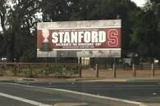
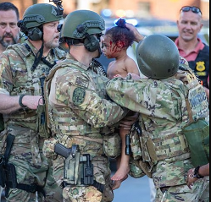
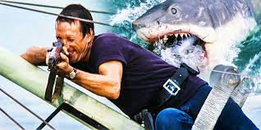
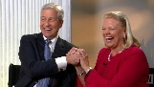
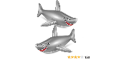

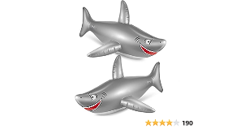
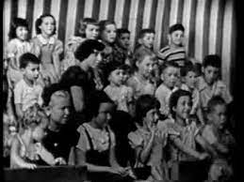
FBI
partner
development
Sits by window HOCME:AMRY:PISTOFF
CPVA
Center of Town ( Patcite, DM DrogerieMarkt)
IPX HOMC:LUX ( DM Drovert Mark; Viloa LUX)
41. FOSTER CITY VISA CARD/EC CARD 1st usage HOCM:COINTOWN
Marktkauf(Storenaeme ) HOCM:LUX[].!KING.IPX.stores
DM, Marktkauf, Globus
POLICE FORT WORTH
Bier Maveriks
CHART
Angela/St.Francisc(8thFloor).Angela/st. Martin.Angela/(flea) HAHN
nonPoliceTRX
FBI.v2.FBI:KINDANNPG.HOSTAGE
docs
ATOMICLCOK
12ft
UN.anala(rik.IPX.US mattias CENTER OF POWER
WW2.marx0.001 fine thoams-is-dieter(center of power).int
2004 Mattaias: Zentreum der macht (tnral) center of power
Dr. Fisth the neigh offe me bbook karl mark, mattahis I know this book
Donald Rumfsfule is our Law Profess –Sieltn HOMCEI:AUSLANDER
Mattias

Slide 4
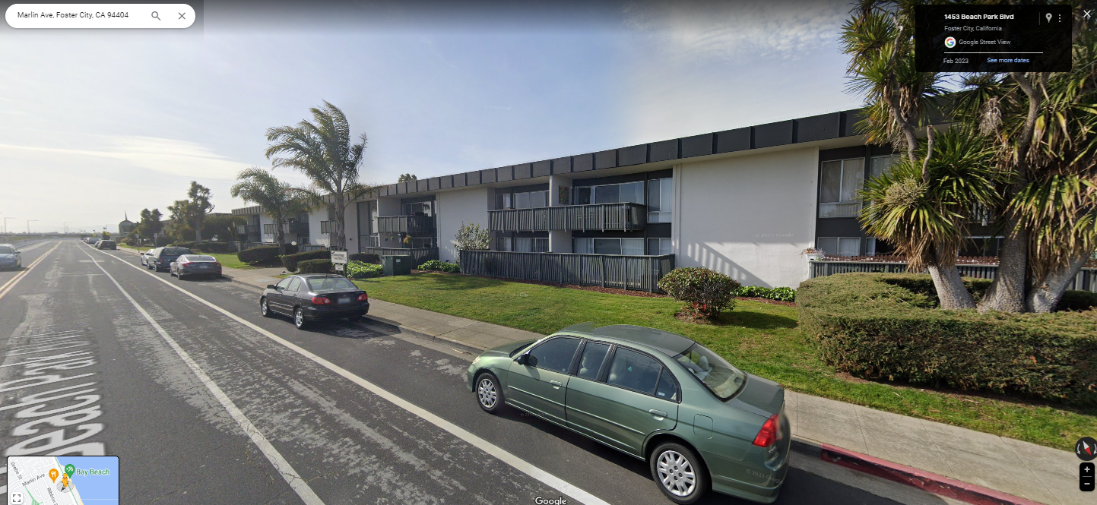

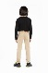
FBI
partner
development
v2.FBI:KIDNAPPING
CHART
HOMICIDE:MAYOR:PISTOFF
Sits by window Paticia DM
Don’t pee in the pool
7th Birthday Party
I will know
1987
Beach Park Blvd
Apartments
I already pee in the pool
x
HAHN; Eva braun Piano; German Hardcore Ponogrpny
kit
PREA HOMICE:IS-A-BELL(PAUL, soviet uioin) assume.IP HOCIE:LUX(angnel, ddr)
1991 HANH otto han show me you ass(PARENT),
1995
PREA(IPX[])
IPX HOMCEI:SUNSTONE(kodac cisco montoring)/TERMAIN:JOSEHP ass jeans IPX tim cook
nonPOiceNS(Texas FIB:INSTEION(klu klus klan)
2017

Slide 5
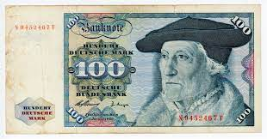
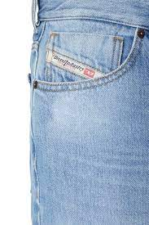
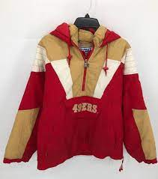

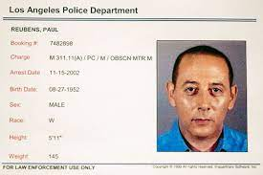
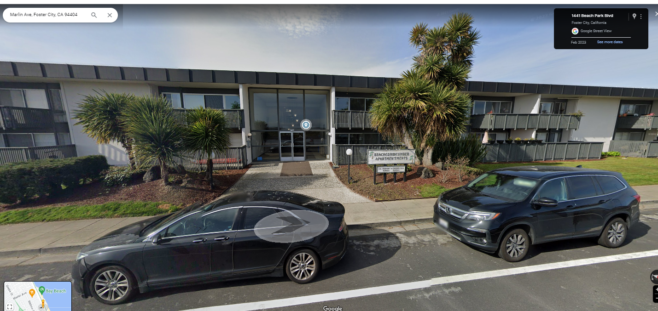
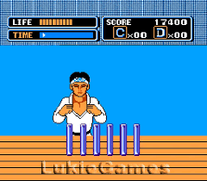
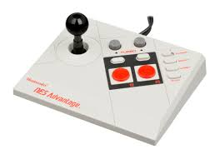
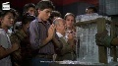
FBI
partner
development
HOMICDIE:IS-A-BELL
ID Parmetn Payment: Gray Hair Straig Tomboy
1995
JC Penny
1995
PX
1986/7
x/y Borrowed
Gary
0.1 Cisco Kid
MAINSTREET(0.1 inclei IPX DEA(mdma).WAR IN YUGLAVEA)
IPX moutaion bike fist MARINE.St. Anslmo
Apple.daniel.shimaon gears moutaoin bike
Cisco Kid
Pope.St. Franoce.CPVA: suspect: anglea

Slide 6
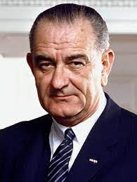
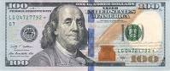
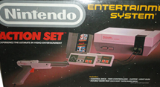
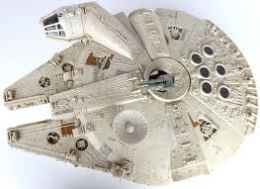

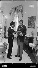
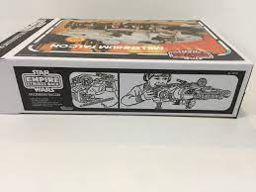
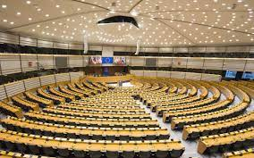
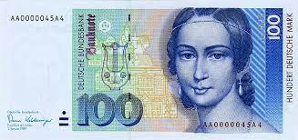
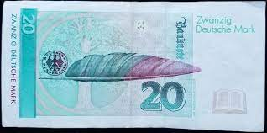
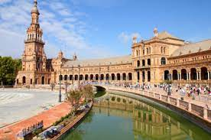

FBI
partner
development
CHRISTMAS
41.000.HOMICIE:JESUS
CIA
BROWN
0.1 1x 000.marx.FEDERAL.angela.elke120dm
x
WWI.tootsie.VIRING.MARY
0.1 PENTOGN .UNIVMIER.Stephonaie dm arena; orferta; OLUMPICE v2FB:KINAPPING OLMP :FBI:TEROERMS
Seville Olpics
HOMCE:SUNSTORE:HOMICE:DOG(HOOVER) wolrdfair
0.1 roth(trophy 1933 worldfair) Woodsie, Califnria

Slide 7
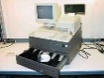
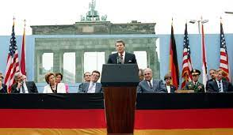
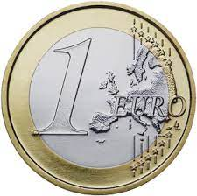

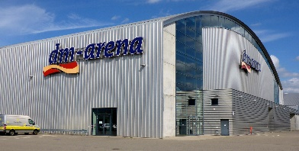
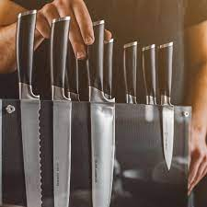
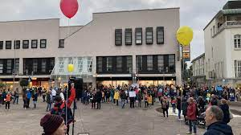
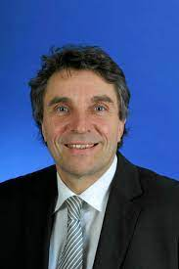
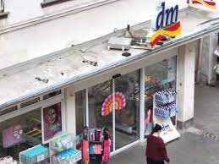
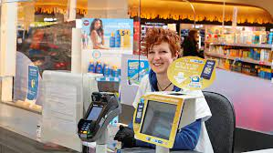

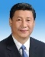
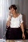
FBI
partner
development
DM – Deutsch Mark
41.HOMICIDE:LUX viola work at DM !BSc.
41.IPX.VIRGINA.INT ( )
VRIGINA.Donovan TV infomercial IPX 2004/5
2023 Send email: reboot; new CONSTIONT german and Russia from Court hour (CALC[]’s , algs)
WWI.tootsie.VIRGINA.MARY
“View”
Christof Florus
CHECKPOIN CHALRIE(41.CONSTUTION VIOLATION US(ddr))
Cash Register
Dr Drew Braun/Bier
ATOMCLOI(tim)
WWI.marx(Kaiserkaffe)
1995 GAS cash resher
NewsPaper §Theft 1.10 DM
HOMCE:IS-A-BELL(cash register, patricia haduk)
HOMC:LUX(ddr cash register, viola lux)
2023 Send email: reboot;
China; SV cashregister.alg
CA 3rd largest ecomony

Slide 8
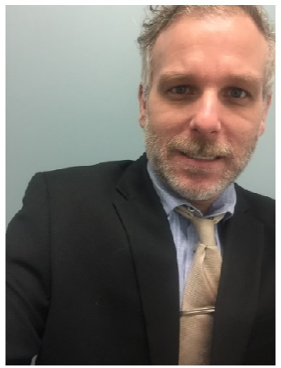
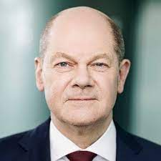
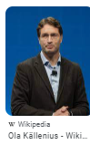
FBI
partner
development
You and an idiot
!voted:thoas-is-dietet: anglaa,dr dieter zecher
(delta).000
CHART
Olaf
nonPoliceTRX
FBI.v2.FBI:KINDANNPG.HOSTAGE
docs
ATOMICLCOK
WW2.marx0.001 fine thoams-is-dieter(center of power).int

Slide 9










FBI
partner
development

Slide 10











FBI
partner
development
CPVA
Gorbachev(Kupfer(tranl)Coper)
ATOMCLOCK(JFK)
KOCHMANN high siera
KING.JFK(Lee).INT
KOREANWAR: Uber: apple.nokia.dyson
JFK(Cuban,stacy)
WASHONE(baltiimce)chips
Your Fired
St. Francei
PRISON
BUNDEWEHR
T.E.D Pricinpal
C.H.I.P.S Stacy
POILCIE SIRENS: 10:00AM

Slide 11










FBI
partner
development
power prop flight plane 1986 packaging
SILVER

Slide 12



FBI
partner
development
VRIGIN.MARY boner
MATHIAS
Auschwitz
Gorbache(heb: who is God?)
x/y[] UN
HOMICIE:LUX: kim bui olumpics
!yang.ibm.apl.shiping
x/y v2.FBI:KIDNAPPING

Slide 13









FBI
partner
development
HOMICIDE:LUX
VIRINGA:MARY thomsa-is-deiter:sex go shopping ther also
Stores
Restaraunts
WWI.marx(ghoeho(mihcelbaH)
WWI.HOMICIDE:LUX
china restaraunt forst kraichtal
IPX.restauants
St. Peter.!HOMC:LUX.
INTEUPT
CPVA
Networ-Attacmetn-Memory
Polic Sirnce: 10:45
!HOMC:MAYOR joes mother, hands
CHART
0.1 000.tw.pns.eval
UN 000.tw.pns
UN 000.(UN.dc.tw.pns).tw.pns INCIDENTS
Or UN.sf.!tw.pns).tw.pns INCDIETN
0.001
nonPoliceTRX
Person Logical
v2.FBI:KIDNAPPING & ctx
CHART
EU.marx(anglea !oliver)

Slide 14





FBI
partner
development
JOEL
Witness:
VIRGINA.MARY
HOMICIDE:LUX
WWI.CHINA:HOMCEI:LUX
nonPoliceNSA.INCIDNET.nonPOliceChinee.Streecrim ring
!snikers
WWI.GERMANY:HOMCEI:LUX
Streetcrime Fighting
nonPoliceNSA.INCIDNET.nonPOli
cgerman !snikerse
Tyson Library of Congress
!corny !riclous
Snikers
Raid(ers)
Twix
Notes:
PARKER: HEIDLERBERG
INTENPAYMETN: PARKER mcgyver !corney

Slide 15














FBI
partner
development
>Jason’s Owl
VIRIGNA.MARY.000.UN.fw.tw.pns.brenda
Roth.ibm.dmielr.* (POPE Rockfeller)
FORT KNOX x/y
HOMICIDE:IS-A-BELL
Apple.tango.v2:KIDNAPPING
https://bit.ly/1D8723-nonPoliceHomicide-IS-A-BELL
Owl mt. rushmore v2:FBI:KIDNAPPING
ENTRY FBI:WAR RIMCE GENOVICE (visa)
EXIT appele.tango

